Slide 1
SILVER DATA LAB
EMPLOYMENT AND SOCIAL POLICY
Employment Rates Vary Far More Between EU Regions Than Between Countries
EU employment reached 76.1% in 2025, 1.9 points short of the 2030 target. Which countries lead, and where the gap between regions is widest.
Silver Data Lab Research Desk · Statistical analysis
Reference period 2025 · Last updated 2026-10-22
silverdatalab.com/studies/european-regional-employment-divide
Notes:
Employment Rates Vary Far More Between EU Regions Than Between Countries
EU employment reached 76.1% in 2025, 1.9 points short of the 2030 target. Which countries lead, and where the gap between regions is widest.
Last updated 2026-10-22
silverdatalab.com/studies/european-regional-employment-divide

Slide 2
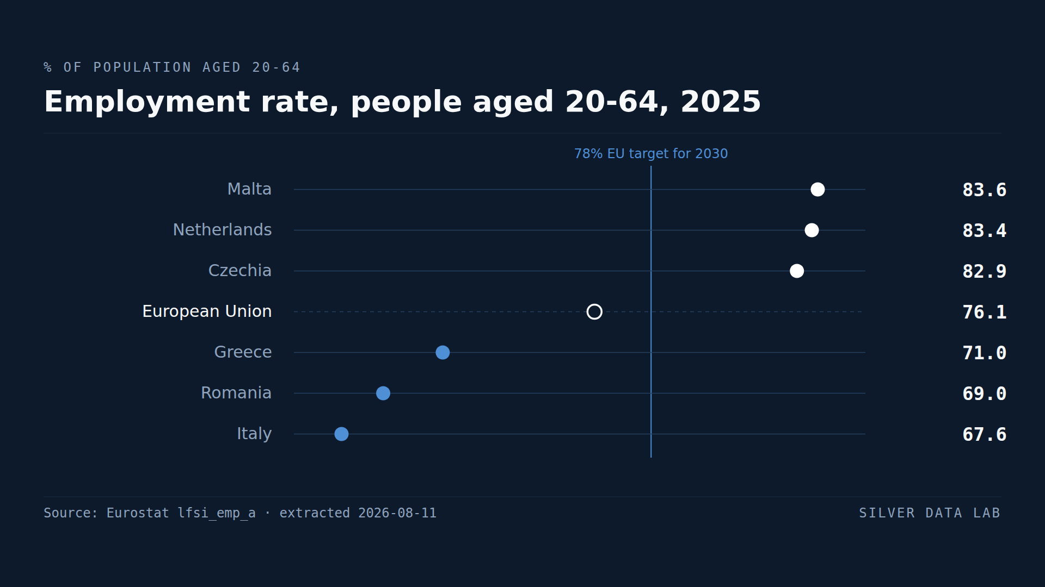
Notes:
Employment rate of people aged 20 to 64 in 2025, highest and lowest EU Member States: Malta 83.6%, the Netherlands 83.4% and Czechia 82.9% above the EU average of 76.1%, and Greece 71.0%, Romania 69.0% and Italy 67.6% below it, all read against the 78% EU target for 2030.

Slide 3
EMPLOYMENT AND SOCIAL POLICY
Key estimates
76.1%
The 2030 target of 78% is 1.9 percentage points away, after a gain of 0.4 points in the last year.
Of people aged 20 to 64 were in employment across the EU in 2025, or 197.8 million people — the highest reading since the series began in 2009.
Malta leads at 83.6% and Italy trails at 67.6%, a spread of 16.0 percentage points between the highest and lowest Member State.
Italy's position is a gender story: at 58.0% Italian women record the lowest female employment rate in the Union, and the 19.1 point gap with Italian men is the widest anywhere in the EU.
Notes:
Regional distances are far larger than national ones: 36.9 points between the highest region and the lowest comparable one in 2025, against 16.0 points between Member States.

Slide 4
EMPLOYMENT AND SOCIAL POLICY
Employment rate, people aged 20-64, 2025
Employment rate (%)
Notes:
Employment rate, people aged 20-64, 2025
Employment rate (%)
Three highest and three lowest of the 27 EU Member States, with the EU aggregate for reference. The 2030 EU target is 78.0%.
Source: lfsi_emp_a

Slide 5
EMPLOYMENT AND SOCIAL POLICY
Employment rate by NUTS 2 region, people aged 20-64, 2025
Employment rate (%)
Mayotte is lower than every region shown, at 36.9%, and is excluded here: it is covered by a separate annual survey, which makes it not directly comparable with the rest of the series.
Notes:
Employment rate by NUTS 2 region, people aged 20-64, 2025
Employment rate (%)
Three highest and three lowest of the 244 EU regions with a published value, with the EU aggregate for reference.
Source: lfst_r_lfe2emprtn

Slide 6
EMPLOYMENT AND SOCIAL POLICY
What these figures cannot tell you
1
One region falsifies the simple version of the ranking
Mayotte records 36.9% in 2025, below every region named above. It is excluded from the ranking here because Eurostat covers it through a separate annual survey, which makes it not directly comparable with the rest of the series. The definition-differs flag Mayotte also carries is not the reason and could not be: 46 of the 244 regions carry it, every French and every Spanish region among them. The exclusion is legitimate; leaving it unstated would not be. Read as 'the three lowest regions in the EU' without that qualification, the claim is false.

Slide 7
EMPLOYMENT AND SOCIAL POLICY
What these figures cannot tell you
2
Results before and after 2021 are not fully comparable
A break in the series falls on 1 January 2021 with the introduction of the new EU Labour Force Survey framework. Comparisons that span that date — including the 2009 starting point and the decade of gains cited above — carry that discontinuity and should be read as an order of magnitude rather than an exact distance. A second and much narrower break is flagged at 2024, on every French region and every Bulgarian one — 33 of the 244 values. None of the 2025 values carries one, so a comparison between 2024 and 2025 is unaffected by it.
3
Regional figures are by place of residence
Eurostat assigns regional employment by region of usual residence, which can differ from place of work. In metropolitan areas with heavy commuting this inflates the residential regions around a city relative to the city itself, and it is a measurement artefact rather than a labour market phenomenon. It should not be confused with the real exclusion visible in youth and NEET indicators.
4
Corsica's figures are flagged unreliable
Corsica's sample is too small to support reliable regional estimates, and Eurostat flags its value accordingly: in 2025 Corsica is the only one of the 244 regions whose value carries that flag. No figure on this page rests on it. Mayotte is the separate case above: its value is printed only to say why the region is excluded, never to support a claim.

Slide 8
EMPLOYMENT AND SOCIAL POLICY
Methodological note
The employment rate is the share of the population aged 20 to 64 that is in employment. The denominator is the total population of that age band, not the labour force — a rate of 76.1% does not mean that 23.9% are unemployed, since the remainder includes students, carers, the long-term sick and the early retired.
The age band is 20-64 throughout, which is the band the EU's 2030 target is defined on. Eurostat's default view for the regional dataset is 15-64 and produces figures roughly five points lower; the two are not interchangeable. Both extractions used here are archived under data/eurostat/ with their filters recorded, so any figure on this page can be rechecked against the file it came from. National and regional figures are both for 2025, which is the latest year complete in each series.
The national extraction carries the whole published series and both of the units the indicator is published in, the rate and the headcount, so the 197.8 million, the 67.3% recorded for 2009 and the gains over the last decade are read from the same file as the 2025 rates. The EU aggregate's own series begins in 2009, and so does every Member State's except France, which reaches back to 2003, and Sweden, which reaches back to 2005.
The gap between a country and the EU aggregate, wherever it appears, is derived by Silver Data Lab by subtraction and is labelled as derived. So is every other count, spread, distance and middle value on this page: the distances to the 2030 target, the regional spread, the counts of Member States and of regions, and the tallies of flagged values. Eurostat publishes none of them.

Slide 9
SOURCE DATA
Employment Rates Vary Far More Between EU Regions Than Between Countries
Employment and labour force by sex and age — annual data — Eurostat
Filters applied: lfsi_emp_a · freq=A · indic_em=EMP_LFS · unit=PC_POP, THS_PER · age=Y20-64 · sex=T, F, M
Extracted: 2026-10-22 · Source last updated: 2026-09-10 · https://doi.org/10.2908/lfsi_emp_a
Employment rates by educational attainment level, citizenship and NUTS 2 region — Eurostat
Filters applied: lfst_r_lfe2emprtn · freq=A · citizen=TOTAL · isced11=TOTAL · age=Y20-64 · sex=T · unit=PC
Extracted: 2026-09-11 · Source last updated: 2026-09-10 · https://doi.org/10.2908/lfst_r_lfe2emprtn
silverdatalab.com/studies/european-regional-employment-divide · CC BY 4.0

